Slide 1

Hackathon Presentation on
Anomaly Detection in
Cloud Monitor Data
Presented by: Harshada H. More
Date: 14/09/2024

Slide 2

Project Goal:
Create a Machine learning model for Cloud Monitor which provides real-time monitoring of various metrics such as CPU utilization, network traffic, and disk I/O, among others.

Slide 3
objective
Explain the importance of anomaly detection in cloud monitoring.
Agenda
Overview of data
Techniques used to solve dataset.
Tools
Case study
.
Introduction:

Slide 4


Jupyter Notebook
Tools and Technologies Used:
Power BI

Slide 5

Problem and Solution
Problem:
False positives/negatives, scalability, interpretability.
Solution:
Refine models, use hybrid approaches, invest in training and resources.

Slide 6
What is Cloud Monitoring?
Definition: The process of overseeing cloud-based systems and services.
Purpose: Ensure performance, availability, and security of cloud resources.
Examples: AWS CloudWatch, Azure Monitor, Google Cloud Operations.

Slide 7
What is Anomaly-Based Analysis?
Definition:
Anomaly-based analysis focuses on identifying data points that deviate significantly from the norm.
Relevance to Sentiment Analysis:
Helps to detect unusual sentiment trends that may indicate issues or opportunities.

Slide 8
What is Anamoly Detection?
Anamolies or outliers are data points within dataset that appears to deviate markedly from expected output.
It process of finding patterns in data that do not conform to prior expected behaviour.
Anamoly detect is being employed more increasingly in the presence of big data that is captured by sensors(IOT),social media platforms, huge networks ,etc. including energy system, medical devices, banking, network intrusion detection, etc.

Slide 9
Anomaly Detection Overview
Definition: Identifying unusual patterns or deviations from expected behavior.
Importance: Helps in early detection of issues, optimizing performance, and ensuring security.
Use Cases: Performance degradation, security threats, system failures.

Slide 10





Steps For Model Development
Step 1:
Study Information
Step 3:
EDA
Step 2:
Basic Check
Step 4:
Model Development
Step 5:
User

Slide 11



Data collection
Model Evaluation
Workflow
End User
Data Preprocessing and analysis
Model Selection & training

Slide 12
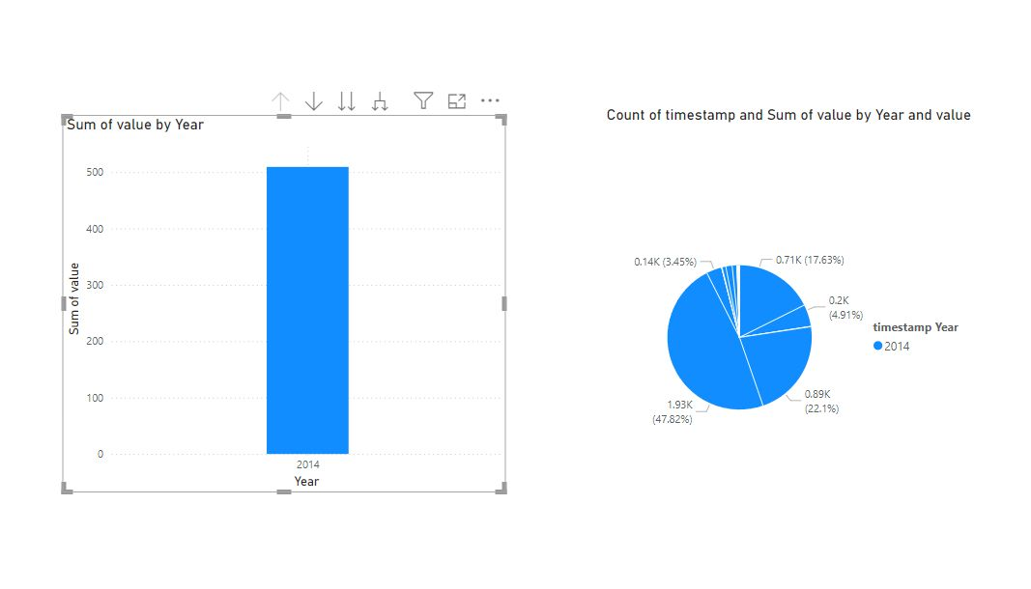
Example of Visualization of dataset of 2014 with the help of Power BI

Slide 13
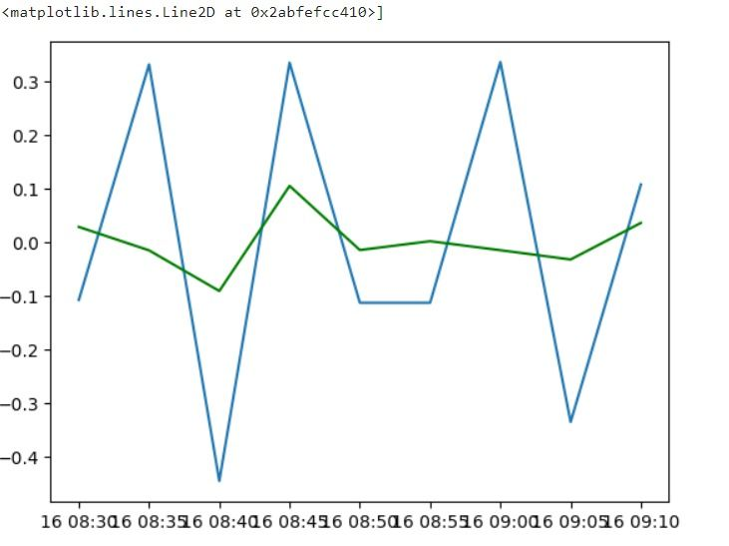


Slide 14
Model Using
Time Series analysis
What is Time Series?
Across industries, organizations commonly use time series data, which refers to any information collected over a regular interval of time in their operations. Examples include daily stock prices, energy consumption rates, social media engagement metrics, and retail demand among others. Analyzing time series data yields insights like trends, seasonal patterns and forecasts into future events that can help generate profits. For example, by understanding the seasonal trends in demand for retail products, companies can plan promotions to maximize sales throughout the year.
There are multiple time series algorithms that are optimized for forecasting continuous values, such as temperature or product sales. A time series model can predict trends based only on the original dataset collected over a period of time.
Types:-
MA
AR
ARIMA
ARMA

Slide 15
Types:
Types of time series models are moving average, ARIMA etc.The crucial thing is to choose the right forecasting method as per the characteristics of the time series data. The following are some of the basic time series models:
MA(Moving Average)
A moving average is defined as an average of fixed number of items in the time series which move through the series by dropping the top items of the previous averaged group and adding the next in each successive average. Yt depends only on random error terms Yt = f( εt, εt-1, εt-2, εt-3, ..) or Yt = β + εt + θ1 εt-1 + θ2εt-2 + θ3 εt-3 +…
AR(Auto Regressive)
Autoregression is a time series model that uses observations from previous time steps as input to a regression equation to predict the value at the next time step. It is a very simple idea that can result in accurate forecasts on a range of time series problems.
Yt depends only of past values.
Yt-1, Yt-2, Yt-3 etc * Yt = f(Yt-1, Yt-2, Yt-3… ) * Yt = β0 + β1Yt-1 + β2Yt-2 + β3Yt-3 …
ARMA
Time series, autoregressive–moving-average (ARMA) models provide a parsimonious description of a (weakly) stationary stochastic process in terms of two polynomials, one for the autoregression (AR) and the second for the moving average (MA).
Combines AR and MA
Yt = β0 + β1Yt-1 + β2Yt-2 + β3Yt-3 …εt + θ1 εt-1 + θ2εt-2 + θ3 εt-3 +…
ARIMA
Autoregressive Integrated Moving Average (ARIMA) model is another widely used forecasting technique that involves the combination of two or more time series models. This model is suitable for multivariate non-stationary data. ARIMA method is based on the concepts of autoregression, autocorrelation, and moving average.

Slide 16
LEARNING OUTCOMES
Adaptability to a different place,set of people and climate.
Real life communication skill.
Improve machine learning skill.
Coping up in a corporate workplace.
There is a always a learning in every change.

Slide 17
Conclusion
Data Acquisition and Preparation:We collected and cleaned time series data from cloud monitoring systems, which included metrics such as CPU usage, memory consumption, network traffic, and error rates. Data preprocessing involved handling missing values, smoothing noisy signals, and normalizing data for consistency.
Analytical Techniques: We applied several time series analysis methods to extract meaningful insights.
Visualization:We perform EDA for data visualization.

Slide 18


